Slide 1
Squaring the Circle Challenge from an Elementary Point of view
Julie Stone, M.ed

Slide 2
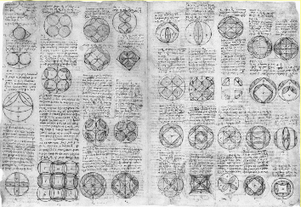
What is Squaring the circle
Artist Leonardo da Vinci was intrigued by the ancient Greek Mathematician Hippocrates, squaring the circle. A complex geometry equation that affects the circle and the square.

Slide 3
Your Challenge
In elementary terms, lets draw, build, arrange, design different patterns using only circles and squares. Very similar to da Vinci.
Your challenge will be to find objects of circles and squares around the house that you can trace. See what kind of patterns you can make by overlapping the shapes just like da Vinci. After you have drawn your favorite design, then add patterns and colors of your choice.
Your design should be original and reflect your personality. When you have completed your artwork write your artist statement to compliment your work do not forget to include the highlighted vocabulary words.

Slide 4
Example of squaring the circle

Slide 5
Artist statement
You can write or record your 3 sentences that describe
Pattern – repetition of shapes, lines, and colors creates rhythm
Overlapping – when lines, shapes and colors are over or under each other
Unity – when lines, shapes and colors work together as a team

